Slide 1
Medicinal chemistry of Antidepressant Drugs
By: Ayana Jaleta

Slide 2
Affective Disorders
Affective disorders are also known as mood disorders
The most common affective disorders are MDD and bipolar disorder
MDD is characterized by depressed mood, loss of interest or pleasure in life, sleep disturbances, changes in appetite, feelings of worthlessness, fatigue or less of energy, diminished ability to focus and frequent thoughts of suicide
irritable or anxious

Slide 3
can be triggered by traumatic life events, hormone imbalance, lack of exercise, medications, drug and alcohol use, and several other factors
healthy lifestyle, including consuming a nutritious diet and exercising regularly is an effective preventive and/or treatment strategy for depression.
However, engaging in a healthy lifestyle may not be effective enough, and medication therapy can help.

Slide 4
Pathophysiology: Biogenic Amine Hypothesis
Brain amines particularly norepinephrine (NE), serotonin (5-HT) and dopamine (DA), and their overlapping roles, are important in mood
decrease in the neurotransmission of NE, 5-HT and DA
functional increase of these catecholamines in the brain synapses results in mood elevation
Prefrontal cortex, hippocampus, amygdala, and insula are regions in the brain that are involved in the pathophysiology of MDD

Slide 5
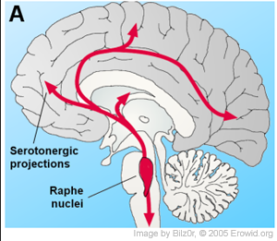
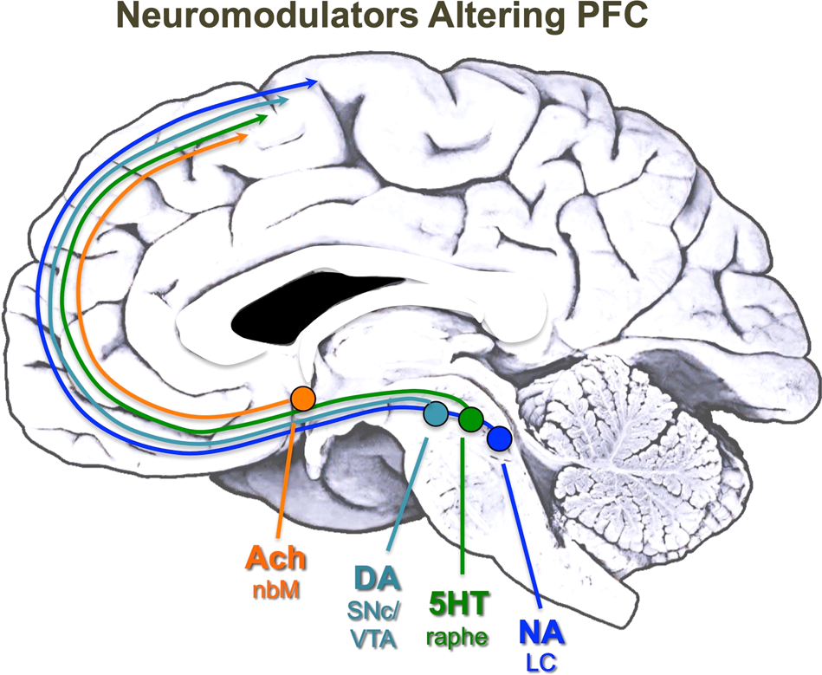
5-HT in the CNS is important in regulating sleep, appetite, impulsivity, sexual behavior, and aggression
impaired 5-HT neurotransmission can decrease cortical responsiveness to emotional reactions and can lead to depression
Noradrenergic fibers: arousal (wakefulness) and autonomic activity
  a dense population of excitatory projections to most of the cerebral cortex

Slide 6
Reduction of NE is associated with a decrease in alertness, energy and interest
NE has the highest affinity for alpha-2 adrenoceptors (i.e. inhibitory)
  low-level NE release may inhibit neuronal activity increased
neuronal transmission arising from NE binding to stimulatory alpha-1 and beta adrenoceptors occurs only at higher NE concentrations

Slide 7
Dopaminergic fibers:
mesolimbic pathway (principle pathway)
motivation and the reward pathway of the brain
DA regulates one’s motivation and desire for reward
D1 receptor:
    most abundant type of DA receptor in the CNS
    stimulatory response.
    mostly in the basal ganglia followed by the cerebral cortex, hypothalamus and thalamus

Slide 8
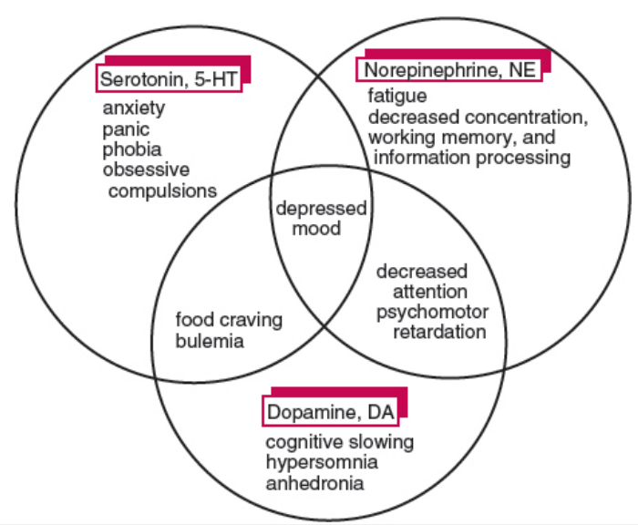
Neurotransmitter deficiency syndromes and their interactions

Slide 9
Receptor Sensitivity Hypothesis
it is not simply the level of NE or 5-HT in the synapse that matters but, rather, the sensitivity of the postsynaptic receptors to these neurotransmitters
depression postsynaptic receptors become hypersensitive to NE and 5-HT because of their depletion in the synaptic cleft.
Low level of NE and 5-HT: increasing receptor sensitivity (hypersensitivity) and an increase in receptor numbers on the neuronal cell membrane, events that may correlate with the start of depression.

Slide 10
Relief from the symptoms of depression comes from a normalization of receptor sensitivity by increasing the concentration of NE and 5-HT in the synaptic cleft.
Antidepressants increase the concentration of NE and/or 5-HT in the synaptic cleft causing the postsynaptic neuron to compensate by decreasing receptor sensitivity (desensitization) and the number of receptor sites (downregulation)

Slide 11
Permissive Hypothesis
The permissive hypothesis emphasizes the importance of the balance between 5-HT and NE in regulating mood, not the absolute levels of these neurotransmitters or their receptors.

Slide 12
Antidepressants
enhance alertness and may result in an increased output of behavior
relief of symptoms of moderate and severe depressive disorder
Depression: feelings of intense sadness or worry, agitation, self-depression, physical changes, such as insomnia, anorexia, loss of enthusiasm, and mental slowing
At any given moment, about 5%–6% of the population is depressed and estimated 10% of the people may become depressed during their lives

Slide 13
heterogeneous disorder that has been characterized and classified into a variety of types
  Reactive or secondary depressor (occurs in response to illness and it is most common).
  Endogenous depression (a genetically determined biochemical disorder).
  Depression associated with bipolar effect (manic depression)
Endogenous depression occurs due to low concentration of various biogenic amines and other modulators of nervous transmission at neuronal level.
Antidepressants are typically taken for at least 4–6 months

Slide 14
Therapeutic uses of antidepressants are as follows:
  Moderate to severe depressive illness.
  Severe anxiety and panic attacks.
  Obsessive compulsive disorders
  Chronic pain.
  Eating disorder.
  Post-traumatic stress disorder
Most of the antidepressants exerts important actions on the metabolism of monoamine neurotransmitters and their receptors particularly norepinephrine (NE) and serotonin

Slide 15
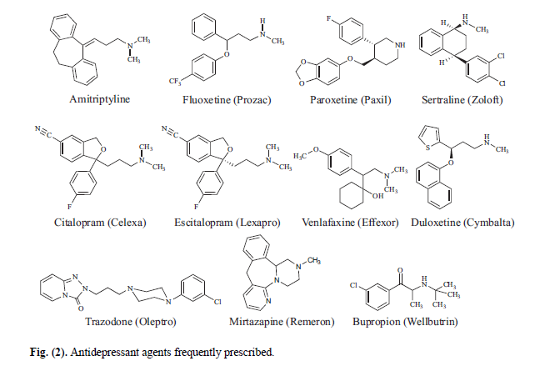

Slide 16
CLASSIFICATION
These drugs vary significantly in their chemical and pharmacological properties.
One convenient way is to combine both aspects and classify accordingly.

Slide 17
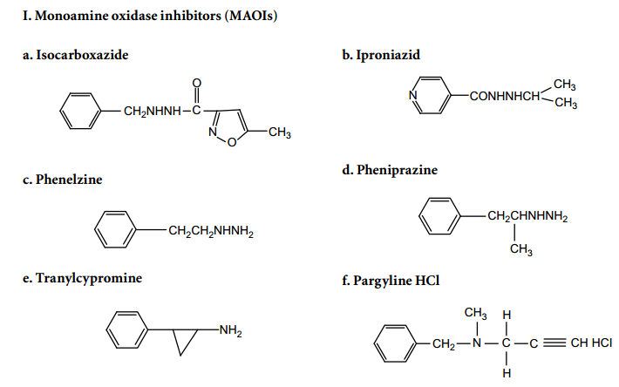
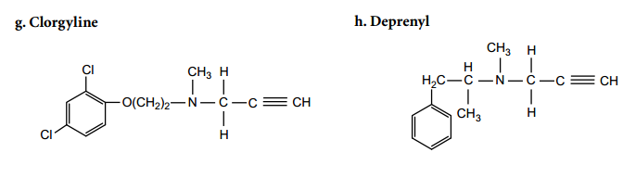
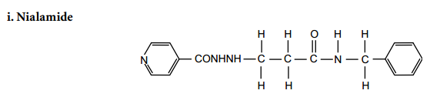
Monoamine oxidase inhibitors (MAOIs)

Slide 18
the action of some of these agents is very rapid, as compared to the lag period of days or even weeks shown by tricyclic antidepressants
All MAOIs act by increasing the available concentration of the neurotransmitters NE and 5-HT
show hypotensive activity as a side effect, and some MAOIs are used as hypotensive drugs

Slide 19
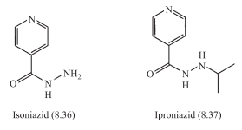
There are four structural types of MAOI: hydrazines, cyclopropylamines, propargylamines, and carbolines
Hydrazines
  only historic significance
  highly hepatotoxic, and are no longer available

Slide 20
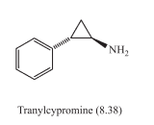
Cyclopropylamines
Tranylcypromine (trans-phenyl-cyclopropylamine) can be regarded as a ring-closed derivative of amphetamine, and therefore provides rapid stimulation as well as protracted effect
produce severe or even fatal hypertensive crises if taken together with foods containing tyramine (irreversible or reversible binding?)

Slide 21
Propargylamines
Pargyline:
used as a hypotensive agent
Incompatible with certain foods and sympathomimetic drugs
may act by negative feedback on norepinephrine synthesis, and has a long duration of action

Slide 22
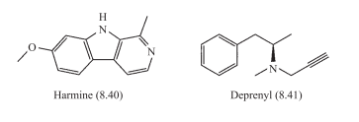
Carbolines(pyrido-3,4-indole ring)
Harmine (8.40) and related carboline alkaloids are reversible MAO-A
inhibitors, but are not used therapeutically.
Deprenyl (8.41) is a selective MAO-B inhibitor and produces an increase in DA levels, but does not influence NE or 5-HT concentrations
It has been proposed as an antidepressant in aging males

Slide 23
categorized according to the saturation of their N-containing six-membered ring:
  unsaturated members are named as fully aromatic β-carbolines (BC);
  partially saturated members are named dihydro-β-carbolines (DHBC);
  completely saturated member are known as tetrahydro-β-carbolines (THBC)
  5-HT reuptake inhibition, interact with 5-HT2A receptors
  probably due to their capacity to inhibit MAO-A preferentially

Slide 24
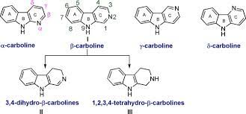
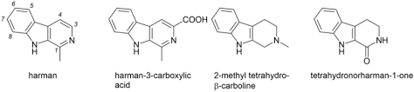

Slide 25
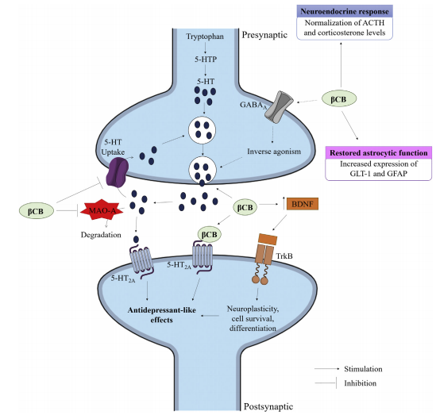
Main molecular mechanisms involved in the antidepressant effects ofβ-carbolines (βCB)

Slide 26
Introducing various substituents at position 9 always resulted in a loss of anti-MAO-A activity, and the potency even weakened as the substituent size increased

Slide 27
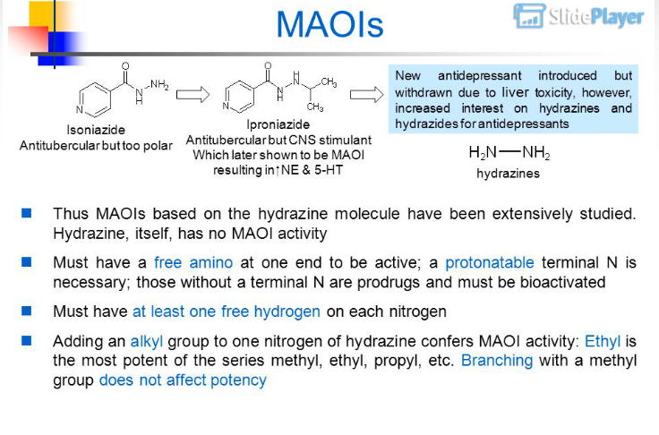

Slide 28
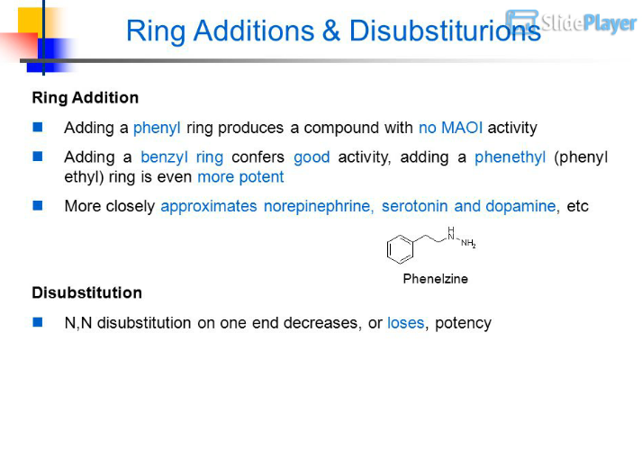

Slide 29
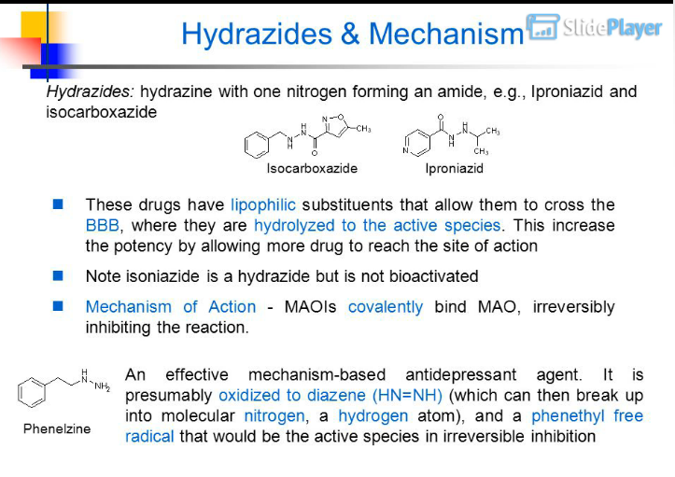

Slide 30
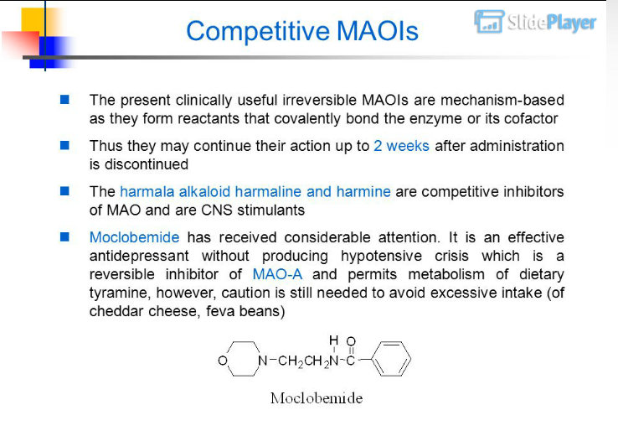

Slide 31
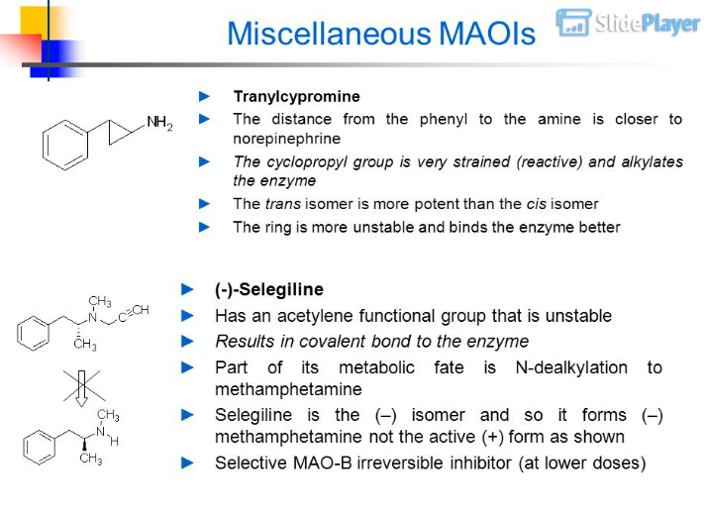
more immediate CNS-stimulant effects than agents that act by MAO inhibition alone.

Slide 32
Monoamine reuptake inhibitors
Tricyclic antidepressant agents(TCA)
Selective serotonin reuptake inhibitors(SSRIs)
Serotonin norepinephrine reuptake inhibitors(SNRIs)

Slide 33
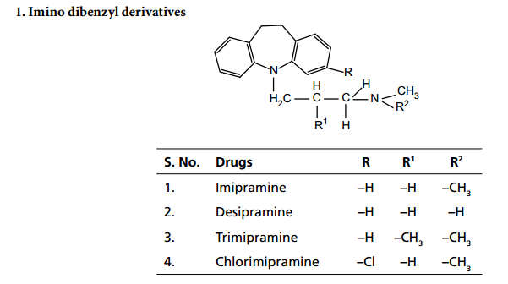
II. Tricyclic antidepressants (TCAs)

Slide 34
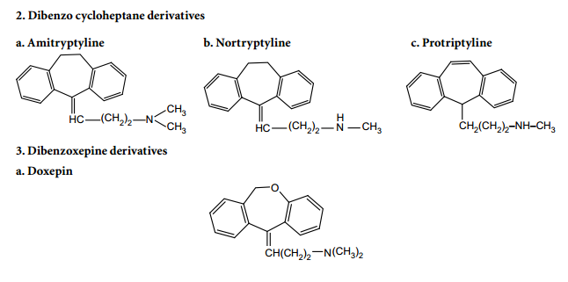

Slide 35
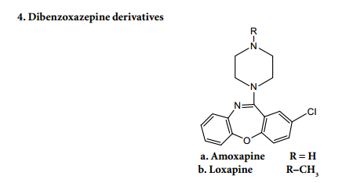


Slide 36
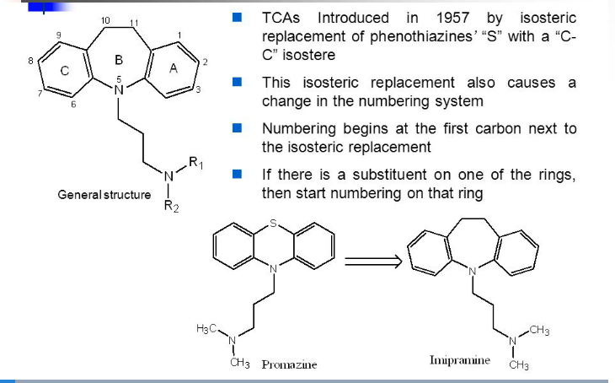
substituted with a 10-11
ethylene bridge

Slide 37
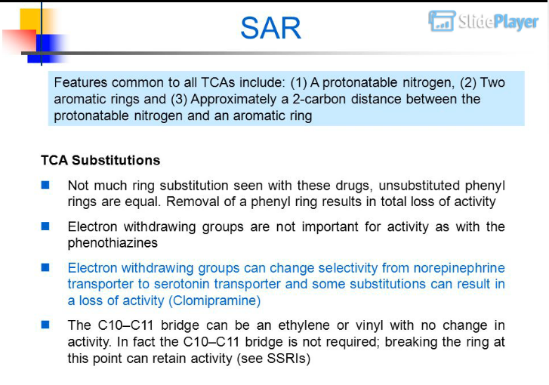

Slide 38
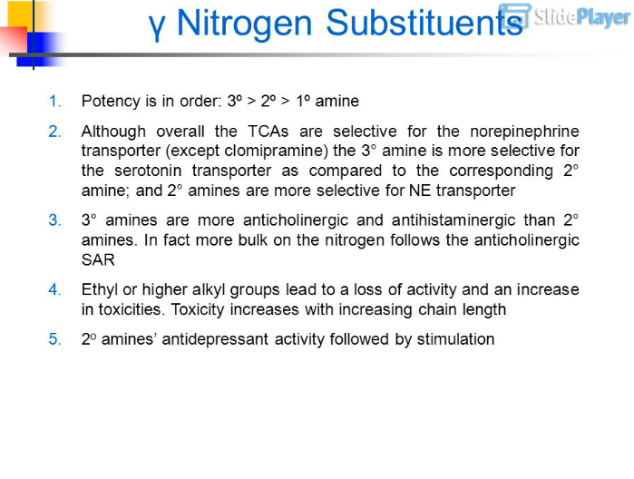

Slide 39
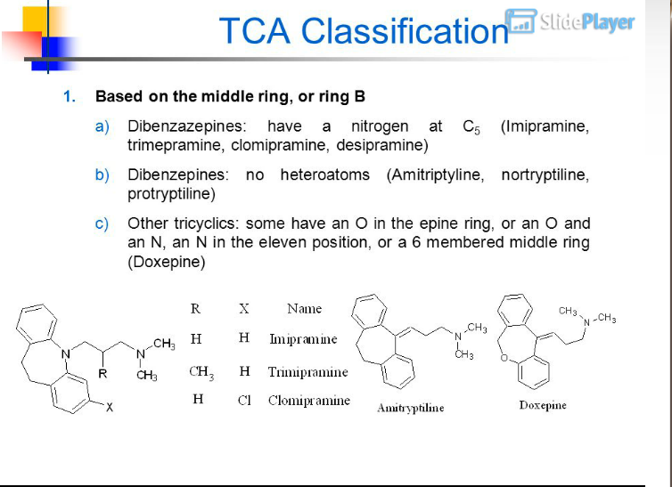

Slide 40
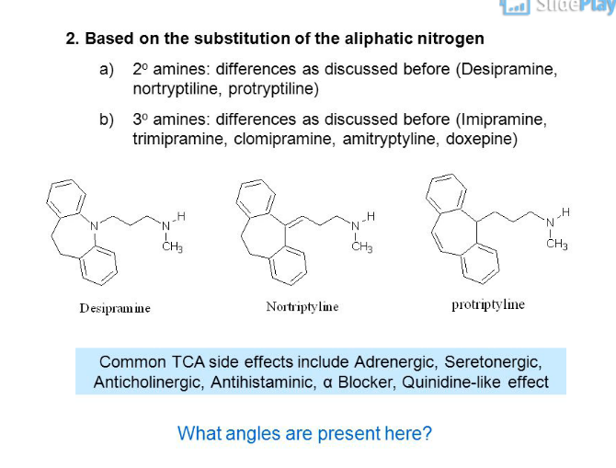

Slide 41
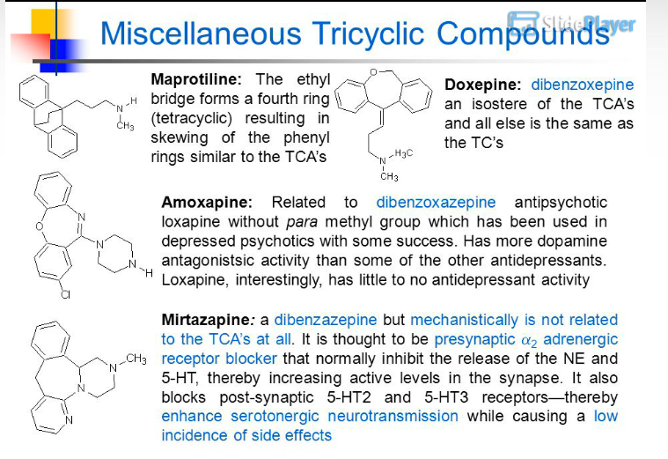

Slide 42
Mode of action
TCAs inhibit the active reuptake of biogenic amines, NE and 5-HT
NE interacts with postsynaptic α and β, presynaptic α2
blockade and inactivation of NE by tricyclics, initially, leads to α2 receptor mediated inhibition of the firing of neurons, and gradually on long-term administration of TCA, desensitize the α2-auto receptors and sensitizes the pre and postsynaptic NA/5-HT receptors and produces enhanced adrenergic and seretonergic transmission

Slide 43
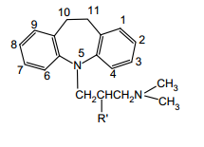
SAR of Dibenzazepines
Variation in the side chain:
Maximum potency: basic nitrogen is separated from TCN by a propylene bridge
Ethylene in between ring and side chain ‘N’ atom gives significant activity
Increase in the ‘C’ length from propylene: ineffective/toxic
Branching does not affect the activity: Imipramine and Trimipramine(same)
carbonyl functionality in position 1 of the propyl side chain: AD activity(imipramine)

Slide 44
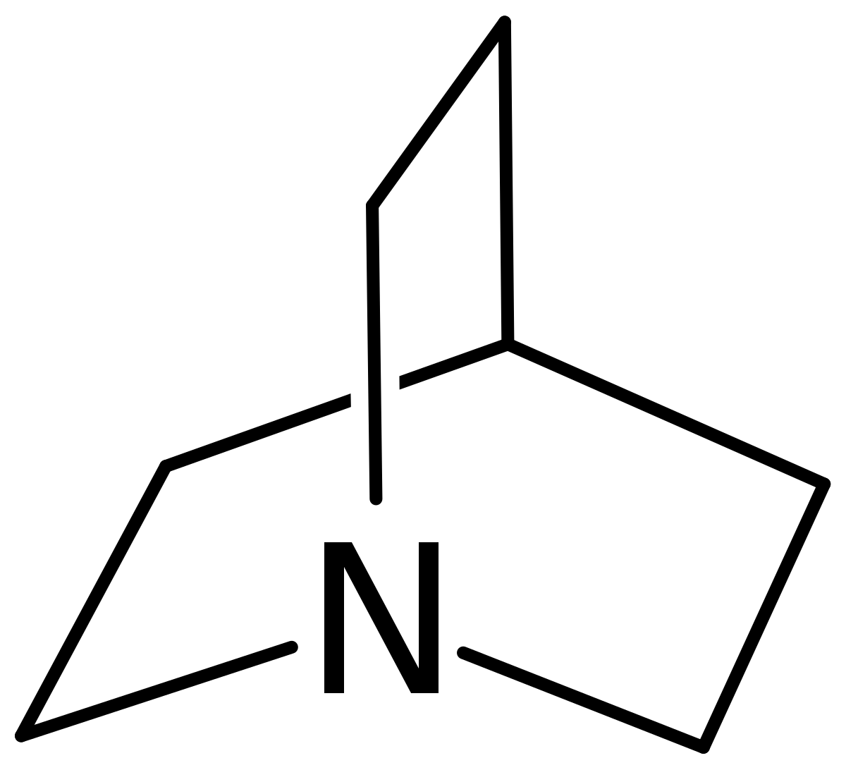
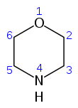
Side chain with quinuclidine, morpholine nuclei claimed to be potent
tertiary amine and secondary amine in the side chain: significantly affect both the monoamine reuptake activity & interaction with other receptors
  tertiary amines are more potent inhibitors of 5-HT reuptake
    more potent activity to α1 adrenergic, muscarnic, and histaminic receptors
  secondary amines are more potent in their inhibition of NE reuptake

Slide 45
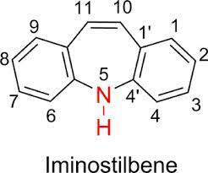
Variation in the ring substituents
chloro-substituent at C-3 : less active than imipramine
dimethyl or keto at C-10 : ineffective
methyl group at 2,8 position or chloro group at 3,7??: ineffective
Variation in the ring system
Iminostilbenes: equally active
Piperazinyl derivatives: ineffective

Slide 46
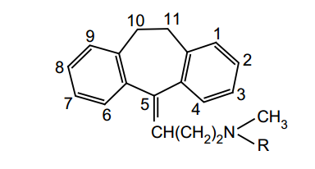
SAR of Dibenzo Cycloheptane Derivatives
–Cl at C-3 shows increase in activity
CH3 at C-3 decreases CNS depression
Removal of N-methyl group of amitriptyline: 2–5 times more potent than amitriptyline(nortriptyline)
double bond between 10 and 11 positions increases the activity.
  exocyclic double bond(Nortriptyline)vs endocyclic double bond
  (protriptyline, less metabolized, longer half life, smaller dose)

Slide 47
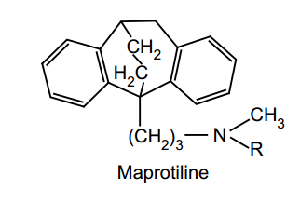
Unsaturation at C-5 enhances activity
When central ring size increases from 7 to 8 members (cyclo-octane), it is more effective
replacement of C-11 of amitriptyline with O, S, SO, SO2, and NH produces clinically effective antidepressant analogues .
Novel bridged derivatives are very powerful, for example, maprotiline is a potent antidepressant, and the time to steady-state concentration is up to 7 days

Slide 48
Imipramine Hydrochloride
the lead compound of the TCAs
a close relative of the antipsychotic phenothiazines- promazine)
has weaker D2 postsynaptic blocking activity than promazine and mainly affects amines (5-HT, NE, and DA) via the transporters
anticholinergic and sedative (central H1 block) effects tend to be marked
high 5-HT-to-NE uptake block ratio (serotonin transport inhibitor (SERTI)

Slide 49
Imipramine is well absorbed (>95%) from the small intestine

Slide 50
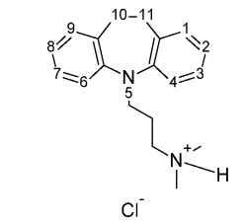
Metabolic inactivation
mainly by oxidative hydroxylation in the 2-position, followed by conjugation
with glucuronic acid of the conjugate
Urinary excretion(about 75%), biliary excretion (up to 25%) can occur, probably because of the large nonpolar grouping.
Oxidative hydroxylation is not as rapid or complete as that of the more nucleophilic ring phenothiazine antipsychotics

Slide 51
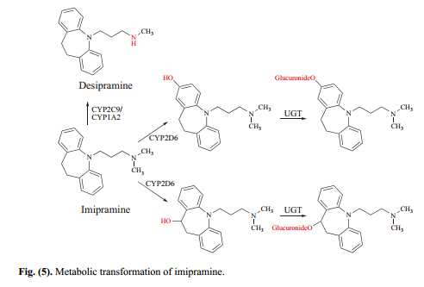

Slide 52
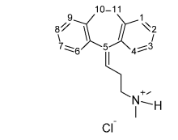
consequently, appreciable N-demethylation occurs, with a buildup of norimipramine (or desimipramine).
metabolite is less anticholinergic, less sedative, and more stimulatory and is a SNERI
Amitriptyline Hydrochloride : 5-(3-dimethylaminopropylidene)-10,11-dihydro-5Hdibenzo[a,d]cycloheptene hydrochloride (Elavil)

Slide 53
one of the most anticholinergic and sedative of the TCAs
lacks the ring-electron–enriching nitrogen atom of imipramine
  metabolic inactivation mainly proceeds not at then analogous 2-position but at the benzylic 10-position (i.e., toluene-like metabolism predominates)
  E- and Z-hydroxy isomers are produced by oxidation metabolism
  N-demethylation occurs, and nortriptyline is produced
    more stimulant action than amitriptyline & SNERI
    sensitive to photo-oxidation and should be protected from light

Slide 54
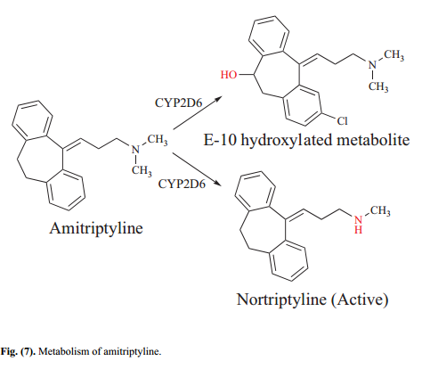

Slide 55
Clomipramine Hydrochloride
more potent antidepressant than imipramine and exhibits greater selectivity for inhibiting SERT uptake in vitro
undergoes extensive plasma protein binding (>97%) and has a large apparent volume of distribution (>1000 L)
metabolized mostly by CYP2D6 to its N-dealkylated and 2- and 8-hydroxylated metabolites
indicated for the treatment of patients with OCD

Slide 56
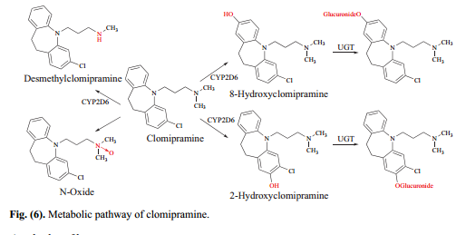

Slide 57
Trimipramine (SurmontilTM)
derivative of imipramine and possesses a dihydrodibenzazepine ring
branched side chain that reduces its affinity for both SERT and NET
rapidly absorbed following oral administration from the gastrointestinal tract and reaches its peak plasma concentration in 2-4 h
Its elimination half-life is 24 h, which is comparatively shorter than for many other TCAs

Slide 58
marketed as a racemic mixture
The (+)- and the (−)-enantiomers of trimipramine are metabolized in a stereoselective manner,
  (+)- trimipramine undergoing an N-demethylation reaction via CYP2C19 and
  the (−)- trimipramine enantiomer metabolized selectively to 2-hydroxytriimipramine by CYP2D6
  genetic polymorphisms in CYP2D6 and CYP2C19 result in variations in PK & plasma drug concentrations

Slide 59
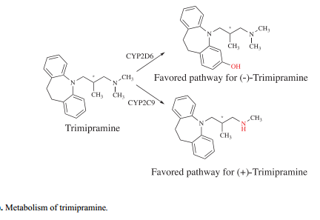

Slide 60
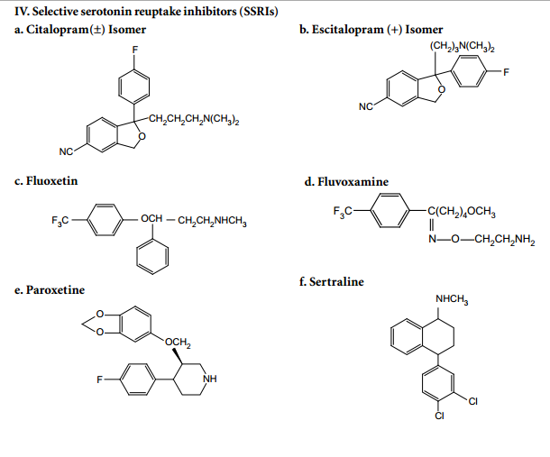
IV. Selective serotonin reuptake inhibitors (SSRIs)

Slide 61
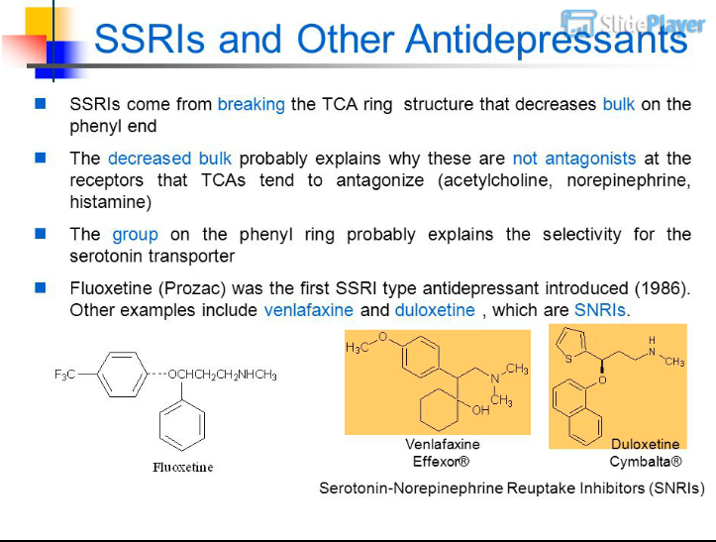

Slide 62
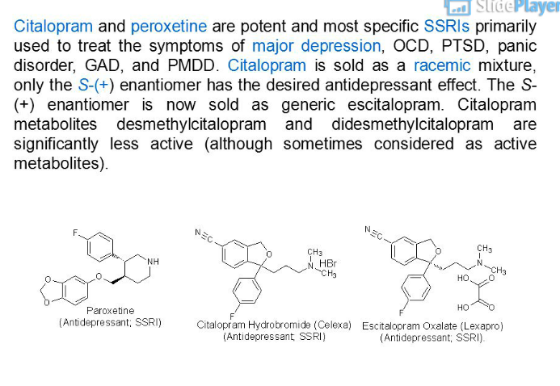

Slide 63
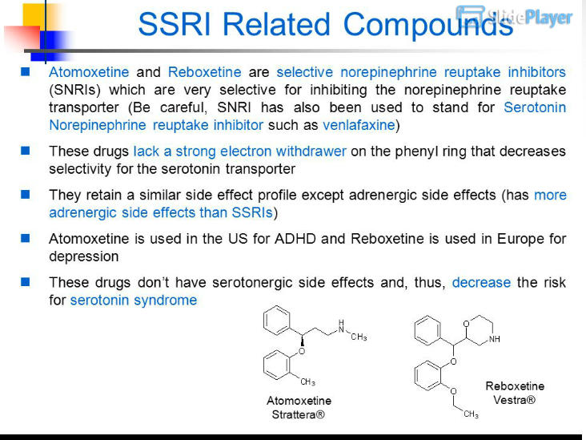

Slide 64
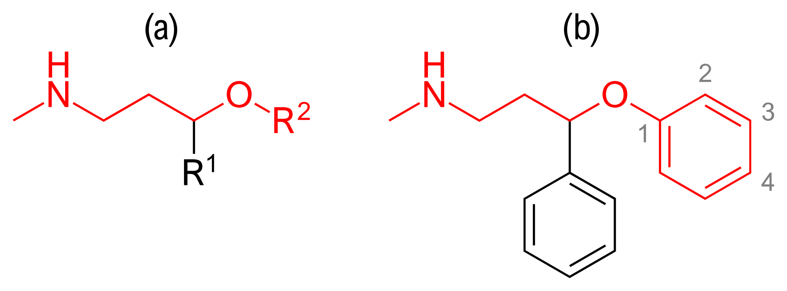
Structure-activity relationship (
Phenoxyphenylpropylamine derivatives:
Compounds containing an aryloxypropylamine motif in their structure, demonstrated in figure 3a, are known as monoamine reuptake inhibitors
derived from the opening of the TCA ring structure
Primary structure of aryloxypropylamine (a) and aryloxypropylamine with phenyl substituents (b)

Slide 65
Opening of the ring significantly reduces the steric bulkiness of the molecule
  relatively lower rate of anticholinergic, antihistaminic, and antiadrenergic activities of SSRIs compared to TCAs
The presence of strong electron-withdrawing substituents on the phenyl or the phenoxy ring is the basis for SERT inhibition selectivity
  primarily at the 4-paraposition, although 3-meta substitutions are also tolerated

Slide 66
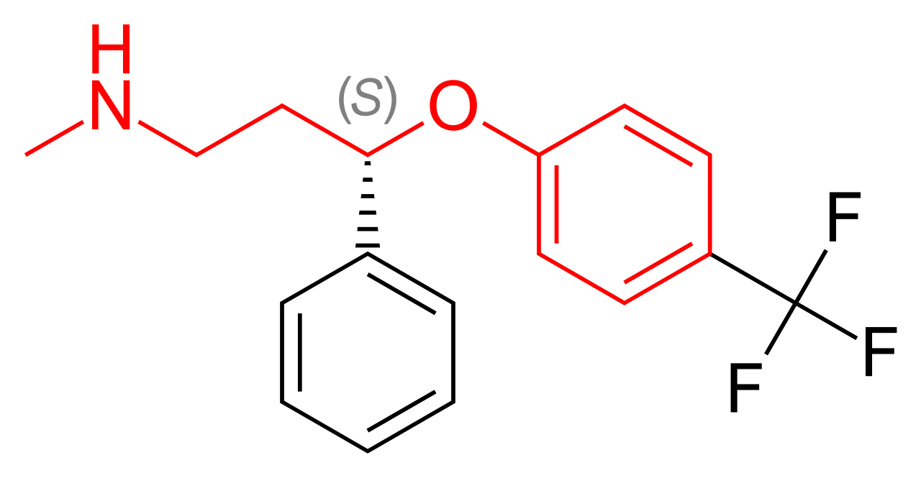
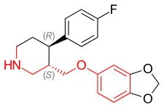
Drugs containing this privileged structural motif, where R¹ and R² are aryls or heteroaryls, preferable phenyl, possess a selectivity profile for NET and SERT
Chemical structure of (–)-(3S,4R)-paroxetine
Chemical structure of (S)-fluoxetine

Slide 67
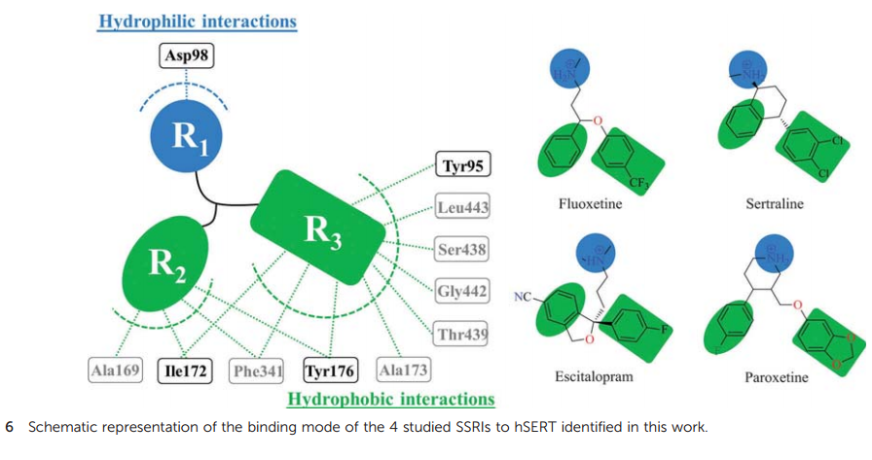
Binding of SSRIs to SERT protein

Slide 68
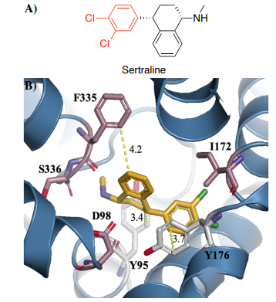
The 2D molecular structure of sertraline.
Electrostatic interactions formed between sertraline and residues Y95 (hydrophobic), Y176 (π-stacking), and F335 (hydrophobic) in the catalytic site of the ts3 hSERT. Distances are reported in Ångströms (Å).

Slide 69
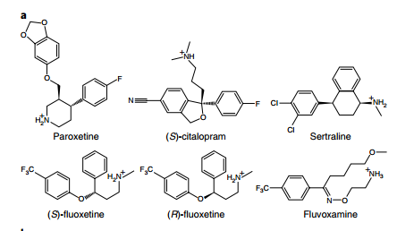
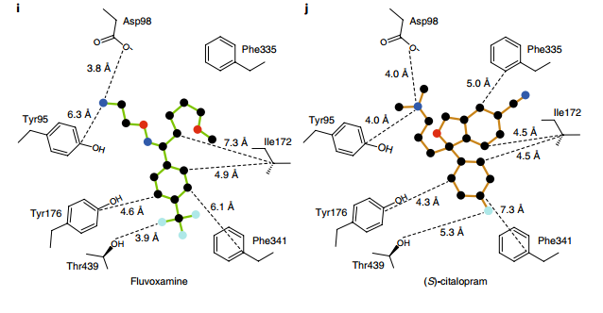


Slide 70

Fluoxetine
protonated in vivo, the protonated amino group can H-bond to the ether oxygen electrons, which can generate the beta-arylamino–like group, with the other aryl serving as the characteristic “extra” aryl.
S-isomer is much more selective for SERT than for NET
trifluoromethyl, an electron-withdrawring group, at the 4-para position confers fluoxetine affinity and selectivity for inhibition of serotonin reuptake

Slide 71
metabolized primarily by CYP2D6 via N-demethylation to their active desmethyl metabolite, (R)- and (S)-norfluoxetine
The (S)-norfluoxetine enantiomer is 1.5 fold more potent than the (R)-isomer in inhibiting serotonin reuptake
well absorbed upon oral administration, is highly PPB (94%) and large V_{d} (20-42 L/Kg)
Fluoxetine has a long elimination t_{1/2} of 4-6 days, while norfluoxetine has an elimination t_{1/2} of 7-15 days
  confers an absence of withdrawal symptoms upon immediate discontinuation of the medication
  CYP2D6 inhibitors(both), nonlinear pharmacokinetics(hepatic insufficiency)
  switching to an MAOI (washout period of at least 5 weeks)

Slide 72


Slide 73
Paroxetine (Paxil TM)
has a phenylpropylamine side-chain constrained into a piperidine ring
the most potent SSRI with no or minimal effects on dopamine and norepinephrine transporters
300 times more selective in blocking the reuptake of serotonin over that of norepinephrine

Slide 74
two chiral centers and is marketed as a single (3S,4R)-(−)-enantiomer
almost completely absorbed from the gastrointestinal tract
widely distributed to tissues, and binds strongly to plasma proteins (93%-95%)
has a shorter plasma elimination half-life of 21 h
withdrawal symptoms upon discontinuation
extensive first-pass metabolism with less than 50% of the dose reaching systemic circulation
mechanism-based inhibitor of CYP2D6

Slide 75

hepatotoxicity
with imipramine or trimipramine is shown to cause reduced oral clearance and increased plasma concentrations of imipramine or trimipramine
Carbene intermediate

Slide 76

V. Serotonin NE reuptake inhibitors(SNRIs)

